Slide 1

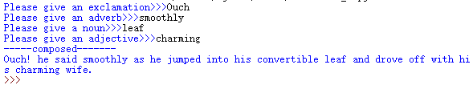
Mad libs – word game
Ask the user for some different words, and then compose into a sentence, or a short story. Make one program and try it by yourself.

Slide 2
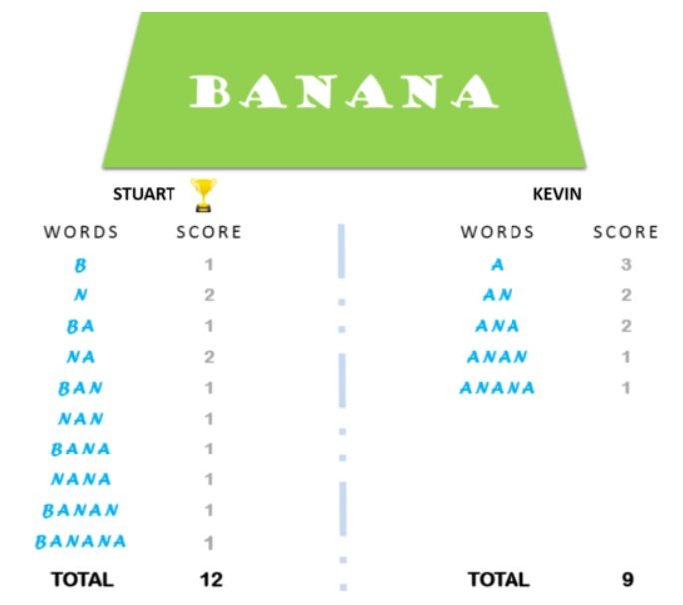
Minion string game
Give a string to 2 player, name them Kevin and Stuart. The string only contains alphabetic letters, no special character or digits. All string must be upper case letters.
Kevin will look for substring start with vowels (‘AEIOU’ are 5 vowels).
Stuart will look for substring start with non-vowels.
See how much they can find. The person who get more substrings win.
Example is for string “BANANA”

Slide 3
Programming Practice
*
**
***
****
*****
******
*******
Shape making with console print:
If you google “ASCII art” or “text art”, you can find more nice shapes/pictures
Chess board:
Normal chess board is 8x8 and each cell is black or white. We use empty space as white, use ‘#’ as black, to print the chess board.
Change the program to allow for any size besides 8.
# # # #
# # # #
# # # #
# # # #
# # # #
# # # #
# # # #
# # # #

Slide 4
Programming practice
*
**
***
****
*****
****
***
**
*
Construct the shape formed by ‘*’

Slide 5
The program get input a symbol for arrow head and arrow body, the output an arrow with them.
Example: if input is
Then output should be:
=
*
*
=========**
=========***
=========**
*

Slide 6
You give a 10 digits phone number to program, and program output it in specific format.
Example: if input is
Then output should be:
0123456789
(012) 345-6789

Slide 7
Make a program to get Student name and Test mark (1~9) from user, then output evaluation result (score 9 ~ Very High, score 8 ~ High, score 7 ~ Above Average, score 4,5,6 ~ Average, score 3 ~ Below Average, score 1,2 ~ Low:
Example input:
Output:
What is the student’s name? >>>Jack
What is the student’s mark? >>>8
Jack achieved ‘High’

Slide 8
The program will read a series of date from user. -1 means the end.
Only those date with correct format will be parsed and output. The correct format are like: “March 1, 1991”; “February 20, 2020”, etc.
The output will be pure number format “MM/DD/YYYY”, like “03/01/1991”, “02/20/2020”, etc.
Example: input
Output
Hint: combine to use string split, replace, slicing, to get the needed information, then do the output.
December 20, 1995
April 1 2010
7/15/20
May 05, 2021
-1
12/20/1995
05/05/2021

Slide 9
Palindrome word
Make a program, which can check if a word is palindrome or not.
Palindrome words, are those words that read from reverse order is same from beginning, like: madam, refer, racecar, etc.
How about words “never odd or even”? If we do not consider space, then it is also palindrome. Can you make your program also detect this situation?

Slide 10
Write a program, which take a string as input from user, the output 2 information:
1. how many letters in the string (letters are A~Z and a~z).
2. how many digits in the string (digits are 0~9)
Write a program, which takes one string from user and check if this string is valid to be used as a password:
At least one letter and one digit
Minimum length 8
Maximum length 16

Slide 11
Programming practice
Write a program, which take a character as input. Program will check and output the character is vowel, or consonant.
Make a program, which takes input Month from user, and gives days of that month.
Example:
Input the name of month: February
No. of days for February: 28 or 29 days

Slide 12
Define your own function
Define a function countBs(), which accepts a string as argument, and return how many ‘B’ in this string.
Define a new function countChars(), which accepts one more argument, this second argument is a one letter string, specify which character want to count. And the function will return how many this character in the string.
Try to use the second function, to make a new countBs function.

Slide 13
Define your own function
Define a function, useonly, which takes 2 arguments: the 1st will be the word to check, the 2nd will be a sequence of letters.
The function will check if the word only contain letters from the sequence, no other letters. If True then return True, otherwise return False.
Define a function, useall, which takes 2 arguments: the 1st will be the word to check, the 2nd will be a sequence of letters.
The function will check, if the word used all the letters in the sequence. (if also used some other letters outside of the sequence is ok). If True then return True, otherwise return False.

Slide 14
Define your own function
Define a function, isabecedarian, which takes argument: the word to check.
The function will check if the letters of the word appeared according to alphabetic order (double or triple letters are ok). If True returns True, otherwise returns False.
Define a function, avoids, which takes 2 arguments: the 1st is the word to check, the 2nd is a sequence of letters.
The function will check if the letters of the word contain any of the letters from 2nd sequence. If does not have any, it returns True. If has, then return False.

